Slide 1
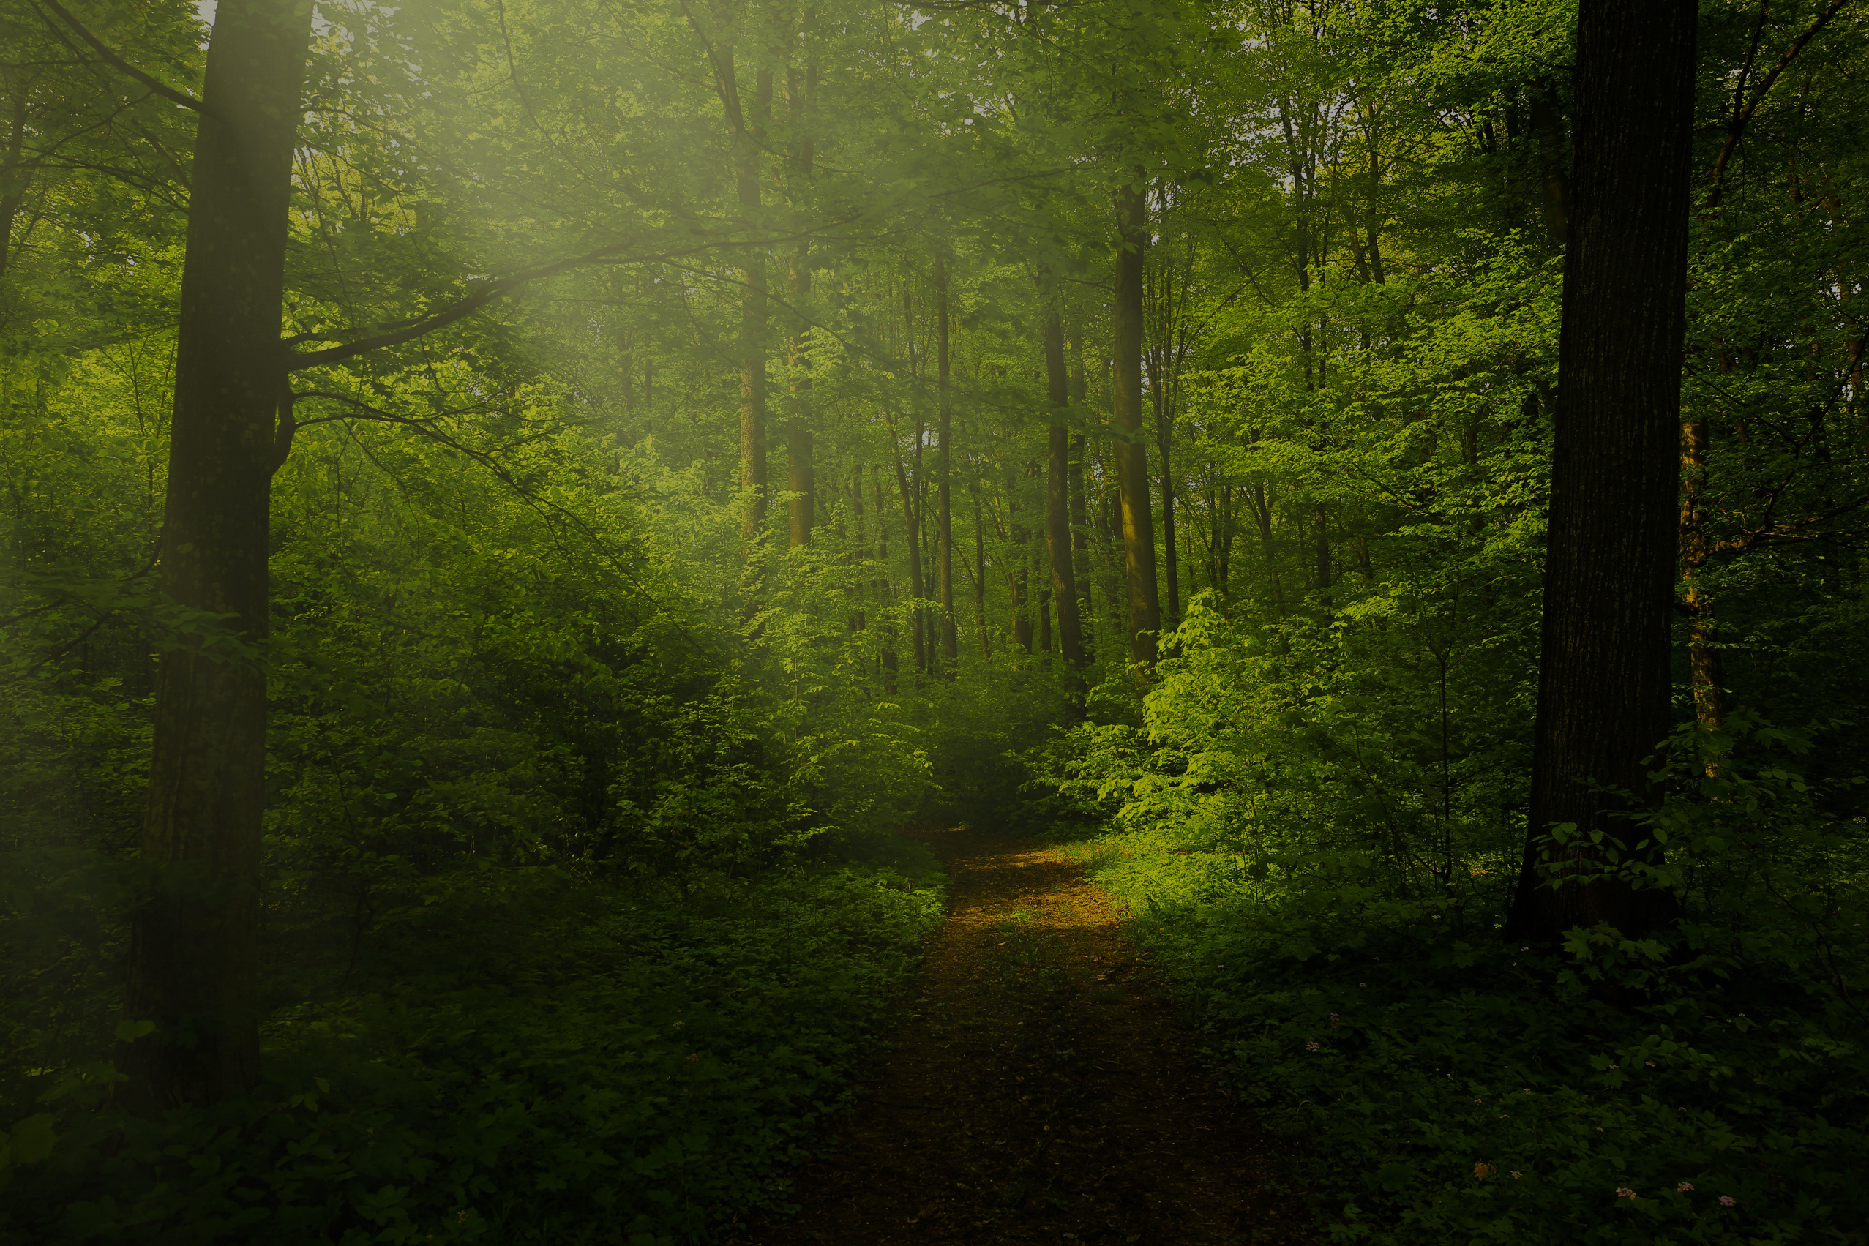
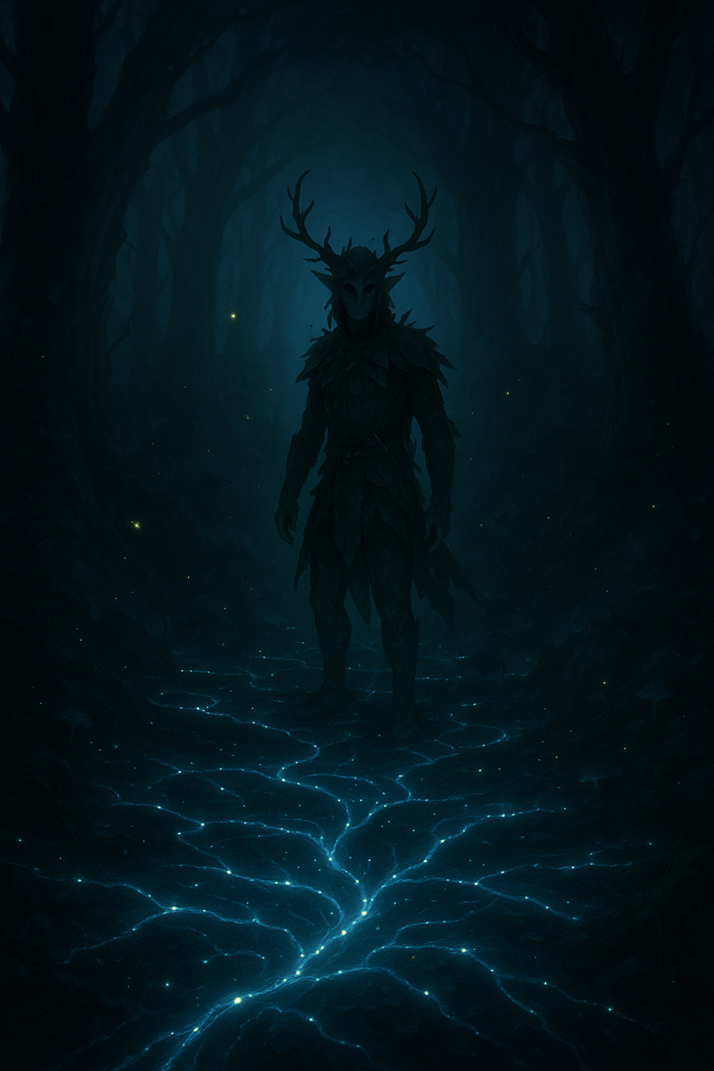
UDRUM & FOREST
“Save the forest and reconnect the soul of the forest.”

Slide 2
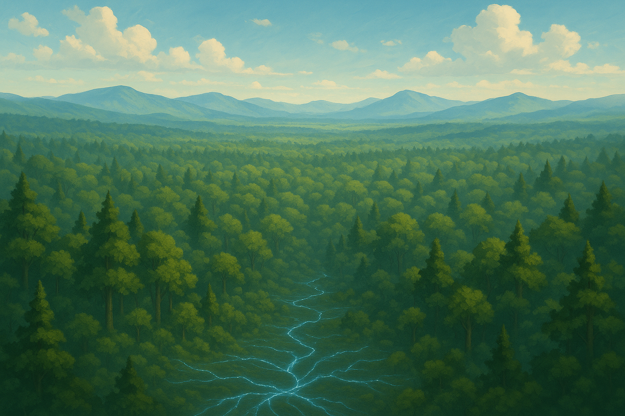
OVERVIEW
<< Stay connected with the forest and save it from danger >>
Udrum, a sylvan creature, is the guardian of the forest who will defend his environment from unconscious actions of man.
inspired by Trentino folklore

Slide 3

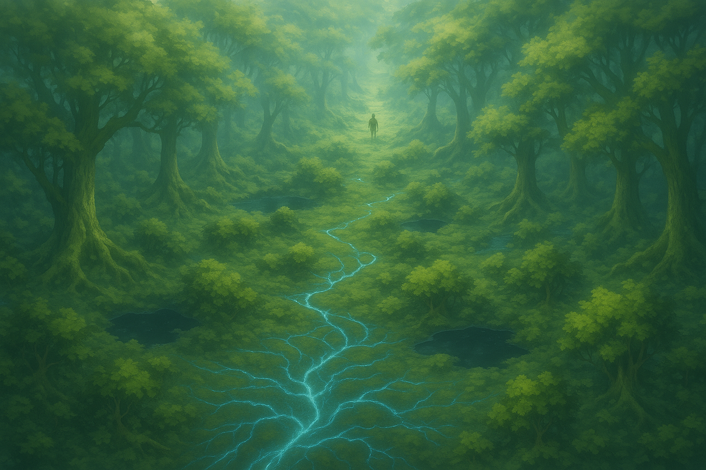
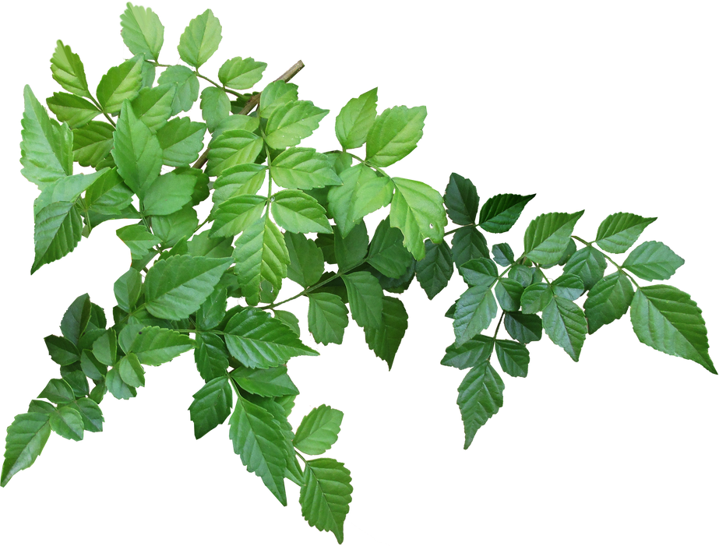
GAME SHEET
Technical data sheet
Genre
Open World Exploration Adventure in first person camera with Environmental Puzzles
Platform
PC-windows os
Game Mode
Single Player
Main Tech
UNITY
Key Market
UE
Languages
IT + EN
Business Model
Buy to Play
Price
19.90 Euro

Slide 4
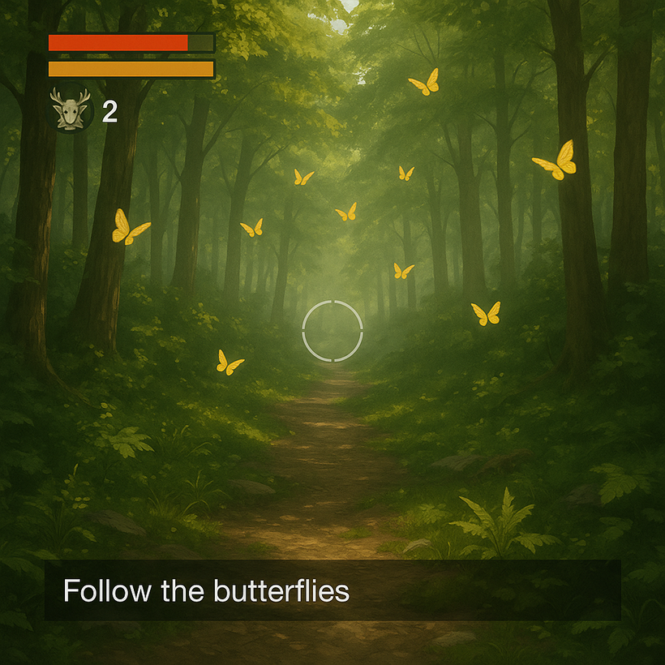
GAME CONCEPT
First-person gameplay, featuring environmental puzzles and narrative missions. The player moves freely through the forest, where every action consumes energy or stamina, encouraging a thoughtful and strategic approach.
• Purification – Interact with mycelium to cleanse corrupted areas.
• Liberation – Rescue trapped animals through environmental puzzles.
• Skill Check – Timed events that require precision to overcome environmental challenges.
• Mycelic Perception – Sensory modality that reveals hidden connections and paths.
• Natural Guidance – Butterflies by day and fireflies by night show the way.
• Ecological Morale – Every action visually and audibly influences the game world.

Slide 5
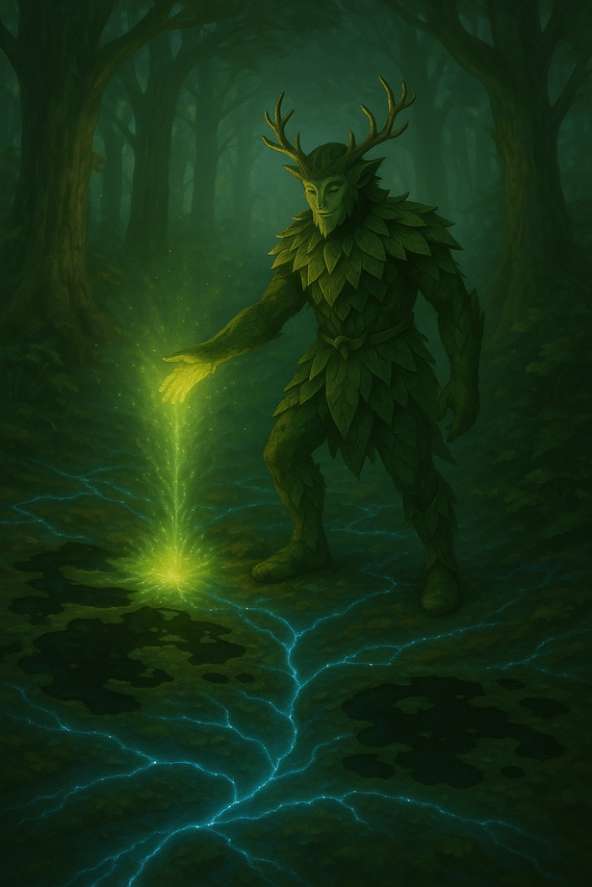
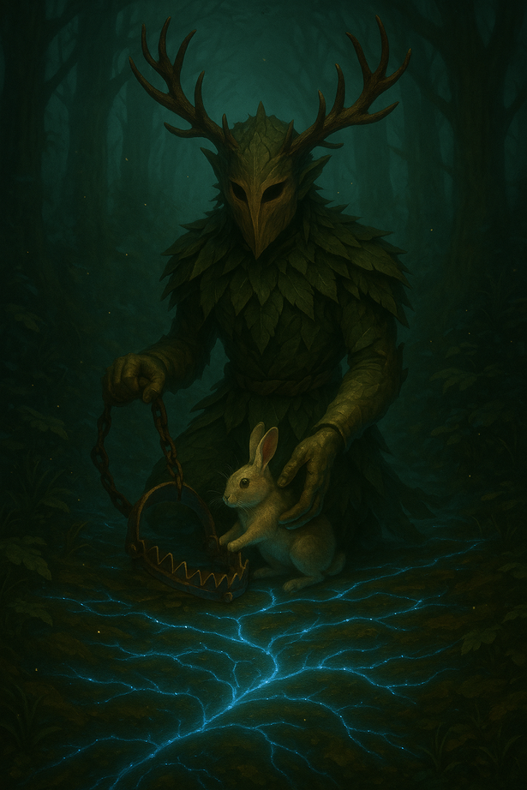
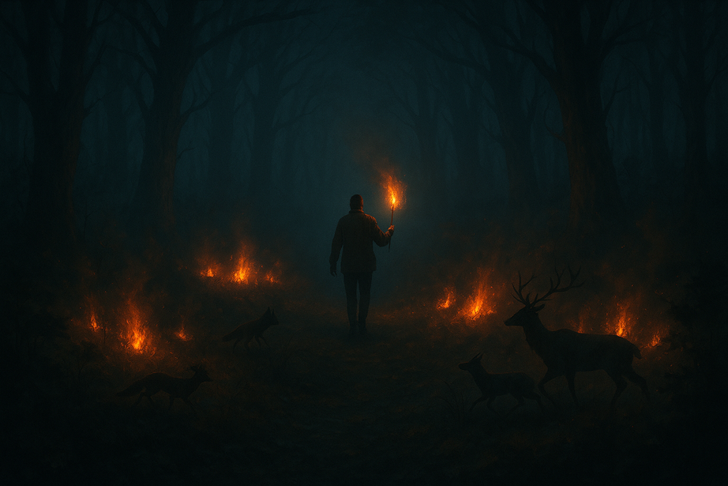
ENVIRONMENTAL PROBLEMS
protect the forest from fires
clean up the forest from polluted pools
free animals from traps

Slide 6
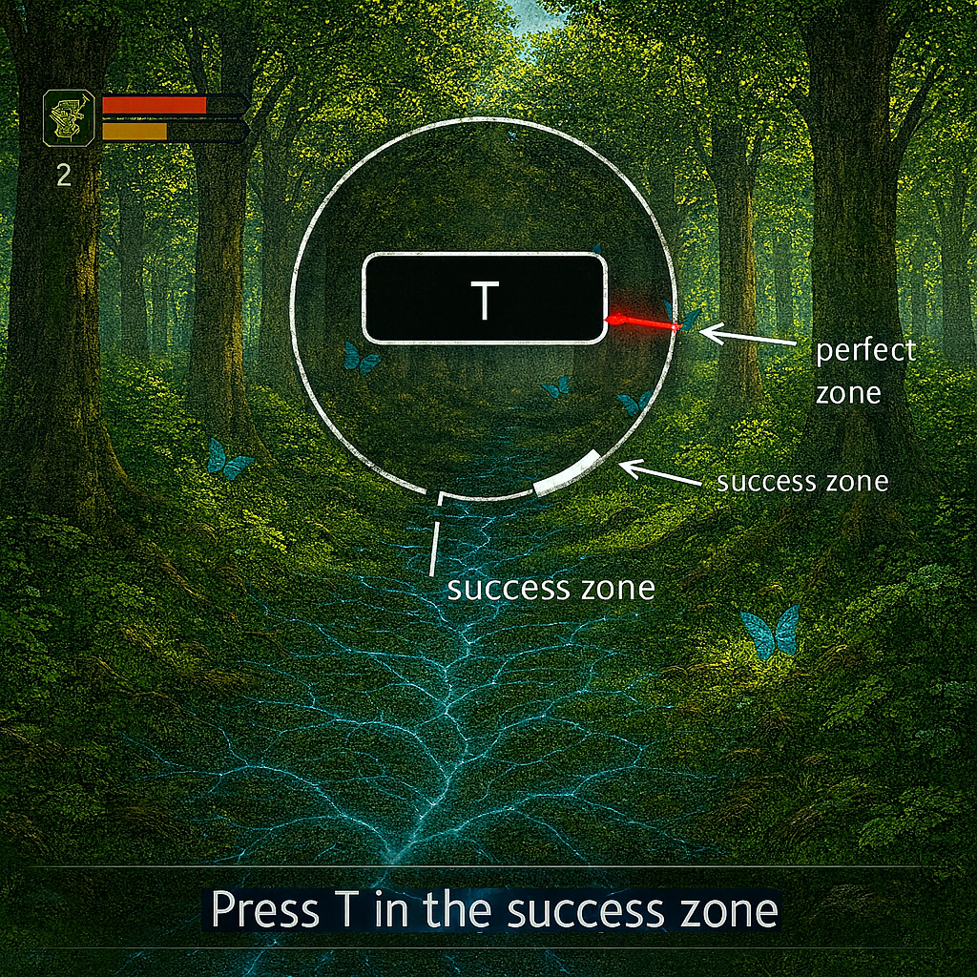
GAMEPLAY
SKILL CHECKS allow the player to solve environmental problems
To win you need perform skill check 3 times

Slide 7
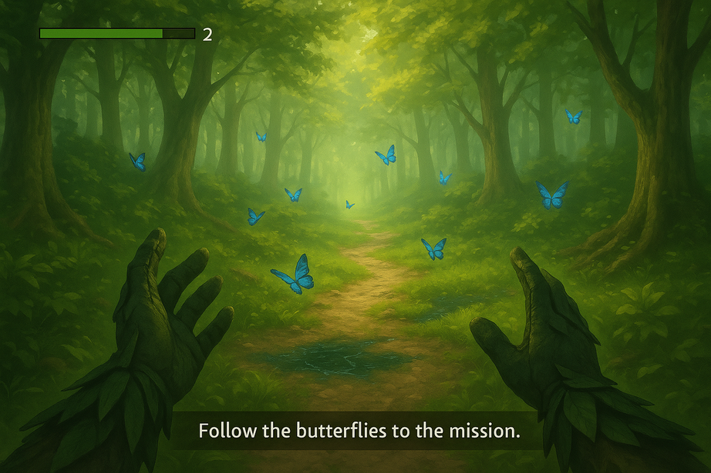
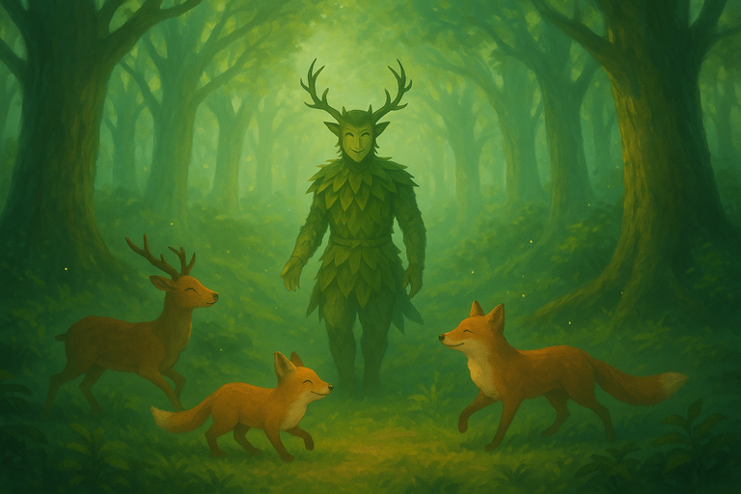
START
GAME LOOP
Reduce paper waste
FOREST MYCELIUM NOTIFIES PROBLEM TO PLAYER
FOLLOW BATTERFLIES OR FIREFLIES
PERFORM 3 SKILL CHECKS
success ??
yes
no
RESTART
YOU LOST

Slide 8
PILLARS
1. Guided Exploration (Diegetic Navigation)
Why: The player must reach Points of Interest (POIs) without intrusive UI or mini-maps.
How: Use butterflies (day) and fireflies (night) as natural guides; glowing mycelium threads subtly indicate direction.
2. Focus-Based Skill Checks
Why: Adds short, tense, skill-based interaction moments that fit the theme of precision and care.
How: Single-button input (“T”), visible success zone, difficulty scales with arrow speed and window size.
Success Metric: Average success rate: 70% at early levels → 55% at advanced levels; clear audiovisual feedback for success/failure.

Slide 9
KEY SELLING POINTS
Diegetic Guidance, No HUD Clutter
Butterflies, fireflies, and glowing mycelium replace intrusive maps and
markers. Immersion and navigation become part of the natural world.
Poetic, Atmospheric World Design
Inspired by forest folklore and bioluminescent ecosystems, the visual and
audio direction creates a sense of wonder and melancholy.
Accessible but Deep Experience
Simple inputs, clear feedback, and short loops make the game
approachable — while systemic ecology and layered progression provide
depth.
Core Moral / Message
Short version (for a tagline): Respect the forest, and it will guide you back
to balance.

Slide 10
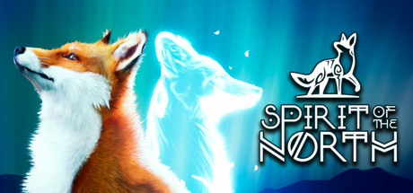
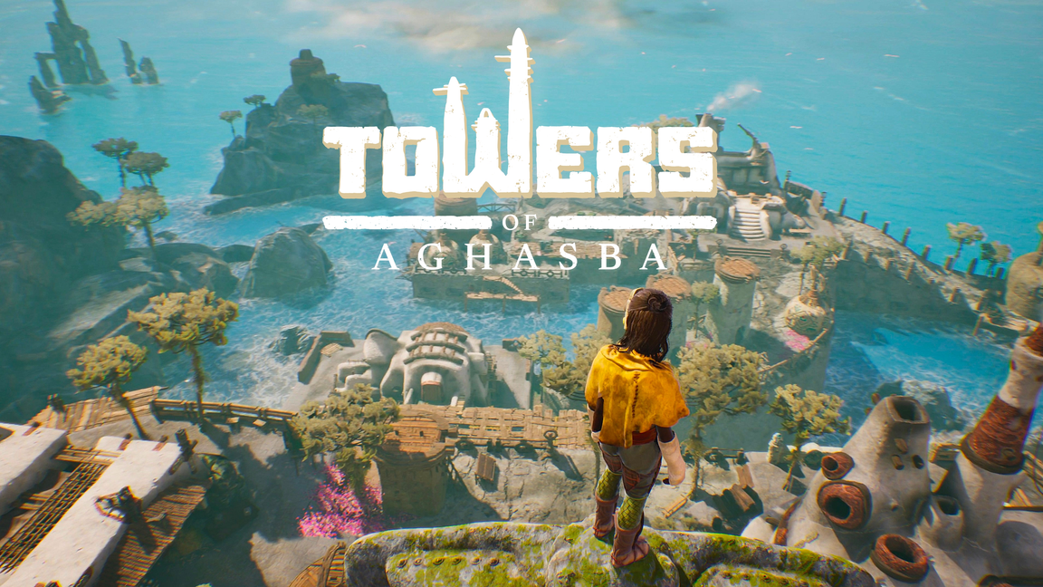
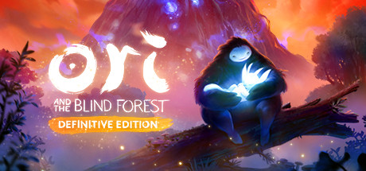
CREATIVE MIX
ispired by various
legends of Nordic folklore.
16,79€
Open World Game in the natural environment
young hero save the forest that was dying
19,99€
28,99€

Slide 11
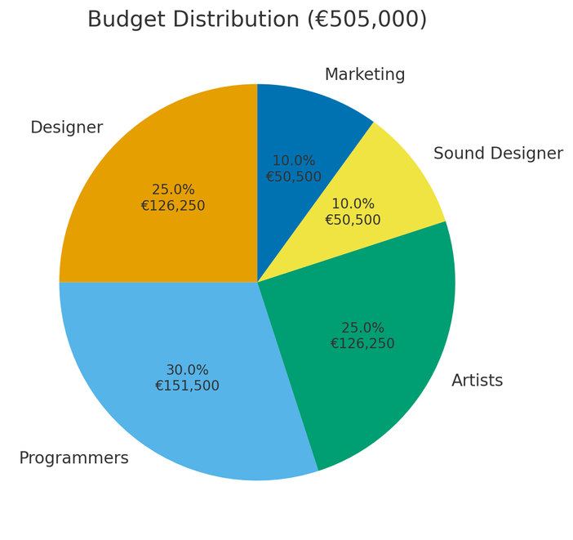
FINANCIAL PROJECTION
BUDGET : 505 000 €
GAME PRICE: 19,90 €
DESIGNER : 25%
PROGRAMMERS : 30%
ARTIST: 25%
SOUND DESIGNER: 10%
MARKETING : 10%
BREAK-EVEN: 36300 copies

Slide 12
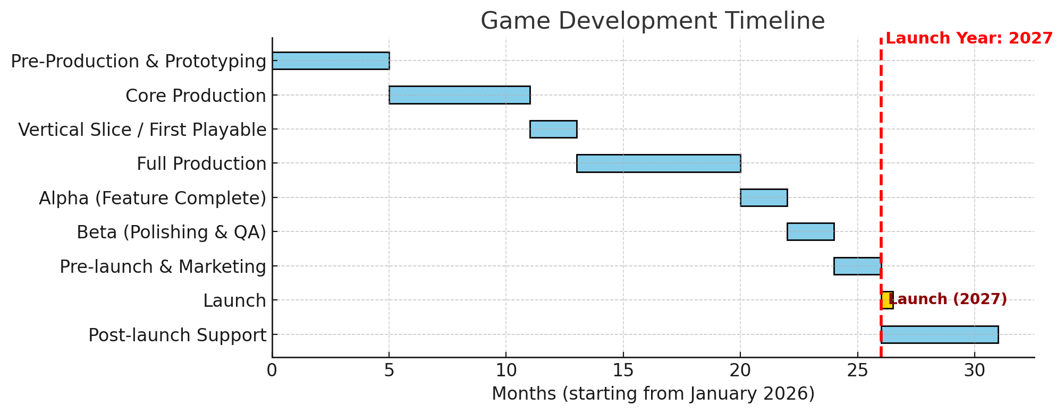
TIMELINE

Slide 13
TEAM
GAME DESIGNER
To be recruited
PROGRAMMERS
Andrea Fraboni
To be recruited
ARTISTS
To be recruited
To be recruited
SOUND DESIGNER
To be recruited

Slide 14
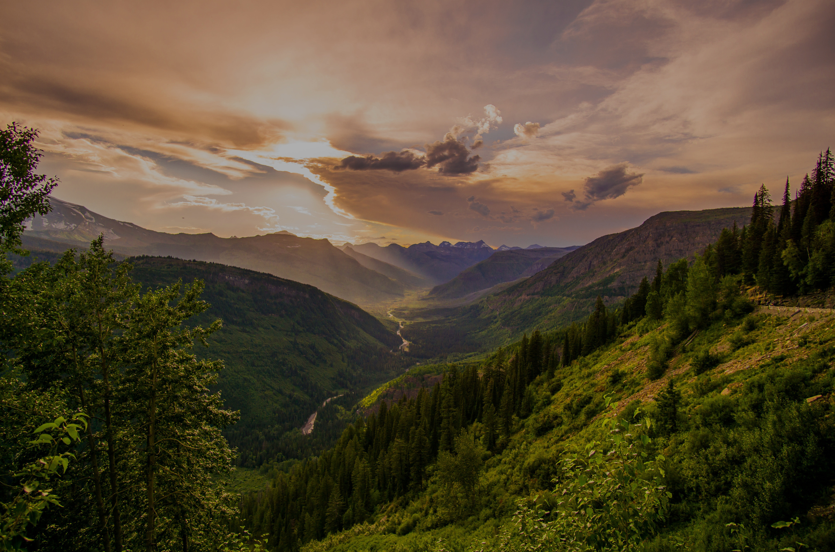
THANK YOU
Let’s keep our Earth green and alive

